Slide 1

Lesson no 2
NETWORK CENTRIC WARFARE

Slide 2
01. The Industrial Age legacy
02. OODA loop
CONTENTS
03. Hierarchy vs Network
04. Network Centric Warfare

Slide 3
01. The Industrial Age legacy

Slide 4
Command includes
the authority and responsibility
for effectively using available resources and for planning the employment of organizing, directing, coordinating and controlling military forces
for the accomplishment of assigned missions.
It also includes responsibility for health, welfare, morale and discipline of assigned personnel.
This definition subsumes control as a part of command.

Slide 5
Degree of centralization
Amount of information
1. Cyclic
2. Interventionist
3. Problem-Solving
4. Problem-Bounding
5. Selective Control
6. Control Free

Slide 6
Order- specific
Interventionist
Cyclic
Objective- specific
Problem-bounding
Problem-solving
Mission-specific
Control free
Selective control

Slide 7
Hierarchy
Decomposition
Specialization
Optimization
Deconfliction
Centralized planning
Decentralized execution
The principles underlying traditional command and control apply to
Industrial Age warfare.

Slide 8
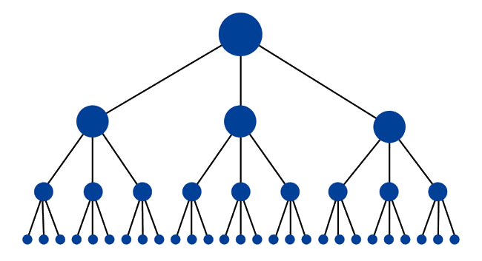
Hierarchy
Brigade
Battalions
Companies
Platoons

Slide 9
Hierarchy
Decomposition
Specialization
Optimization
Deconfliction
Centralized planning
Decentralized execution
The principles underlying traditional command and control apply to
Industrial Age warfare.

Slide 10
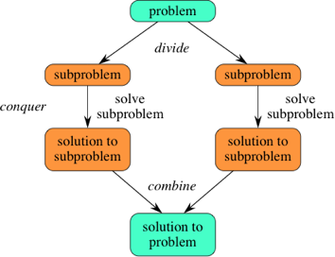
Decomposition
The Industrial Age applied
a “divide and conquer” mentality to all problems.
Academic disciplines, businesses, associations, and military organizations defined their roles as precisely as possible and divided their overall activities into coherent subsets that could be mastered with the existing knowledge, technologies, and personnel.

Slide 11
Hierarchy
Decomposition
Specialization
Optimization
Deconfliction
Centralized planning
Decentralized execution
The principles underlying traditional command and control apply to
Industrial Age warfare.

Slide 12

Specialization
In military affairs, specialization (creation of career branches and very specialized organizations) enabled much more efficient career development and training.
During military operations, the specialized capabilities often generated capacities that simply could not be created by groups of generalists.

Slide 13
Hierarchy
Decomposition
Specialization
Optimization
Deconfliction
Centralized planning
Decentralized execution
The principles underlying traditional command and control apply to
Industrial Age warfare.

Slide 14
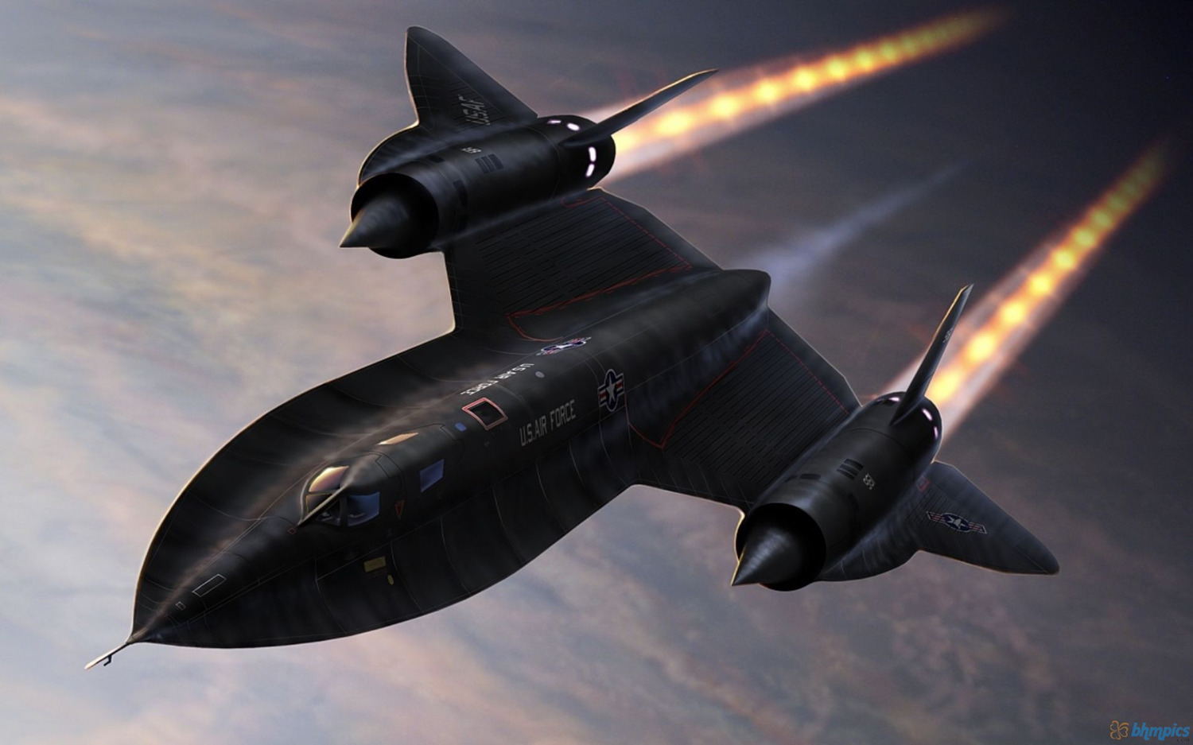
Optimization
A characteristic assumption of the Industrial Age was that every problem had a “best” solution and every asset had an ideal employment.
This was most obvious in the design of weapons systems that were optimized against the set of threats considered most likely and most dangerous to national interests.

Slide 15
Hierarchy
Decomposition
Specialization
Optimization
Deconfliction
Centralized planning
Decentralized execution
The principles underlying traditional command and control apply to
Industrial Age warfare.

Slide 16
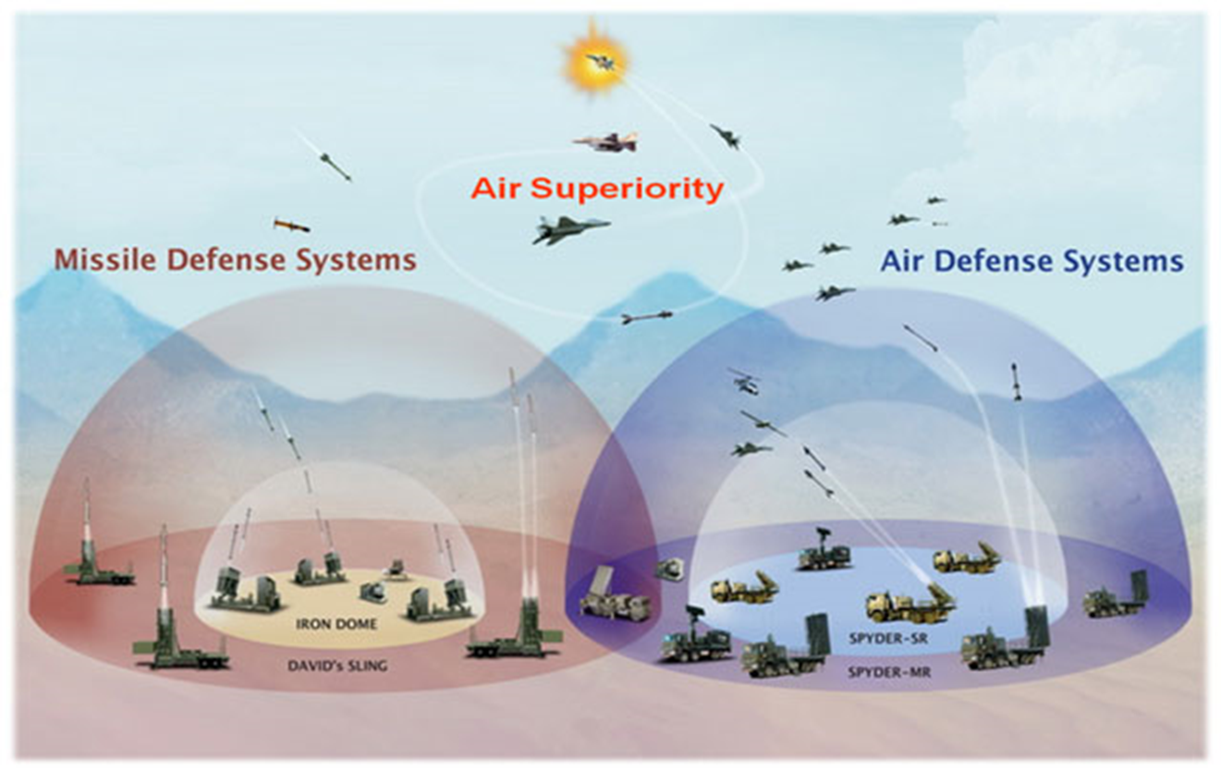
Deconfliction
Given that the elements of military forces were optimized for specific missions under well known and understood circumstances, Industrial Age command and control processes relied heavily on control measures that would deconflict the elements of the force.
These control measures included:
• Unit boundaries;
• Altitude restrictions on aircraft;
• Assignment of logistics facilities (road, rail, airfield, port)

Slide 17
Hierarchy
Decomposition
Specialization
Optimization
Deconfliction
Centralized planning
Decentralized execution
The principles underlying traditional command and control apply to
Industrial Age warfare.

Slide 18
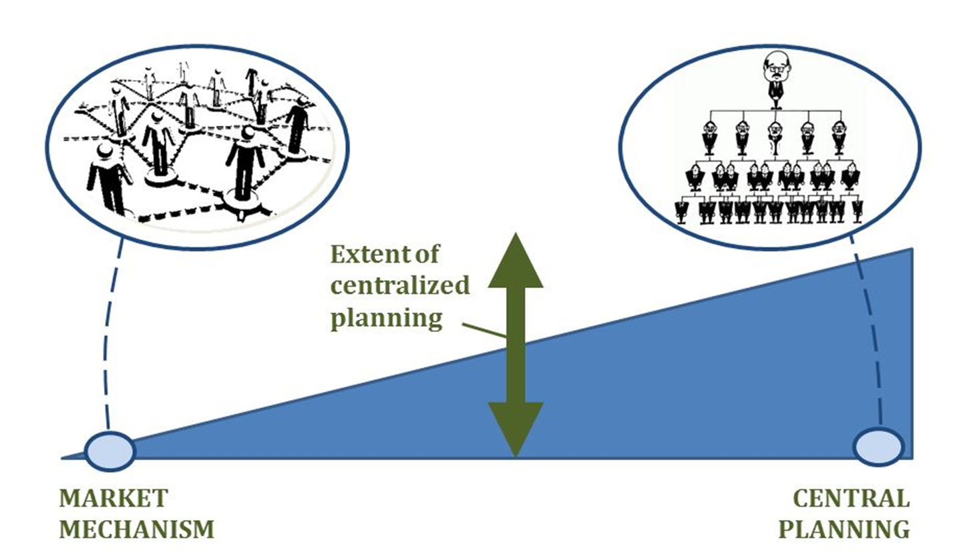
Centralized planning
Planning became a crucial part of Industrial Age command and control because it enabled commanders to arrange forces and events in time and space to maximize the likelihood of success
(mission accomplishment).

Slide 19
Hierarchy
Decomposition
Specialization
Optimization
Deconfliction
Centralized planning
Decentralized execution
The principles underlying traditional command and control apply to
Industrial Age warfare.

Slide 20
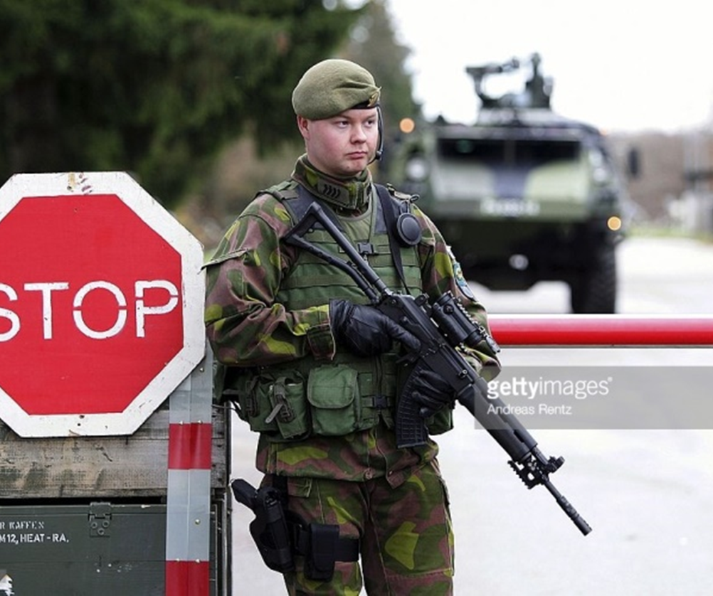
Decentralized execution
Industrial Age commanders were, however, aware of the fragility of plans in the face of the harsh and dynamic operating environment of combat.
Perhaps the most famous quotation about planning from that era is,
“No plan survives first contact with the enemy.”
Understanding the limits of military plans, commanders encouraged initiative (innovation and aggressive actions) and decentralized execution within the overall commander’s intent.

Slide 21
02. OODA loop

Slide 22
O
Observation
O
Orientation
D
Decision
A
Action

Slide 23
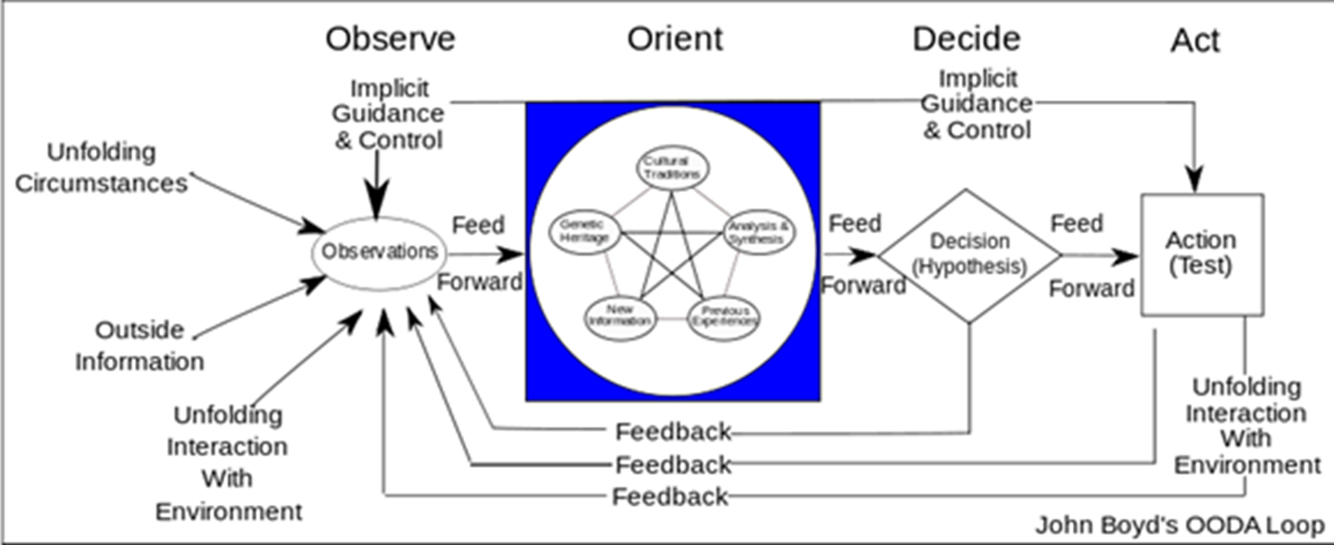

Slide 24
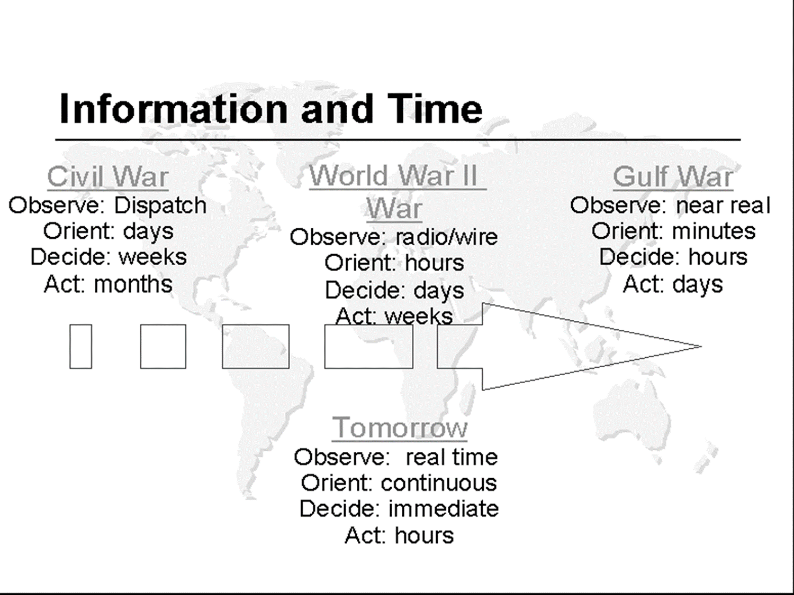

Slide 25
03. Hierarchy vs Network

Slide 26
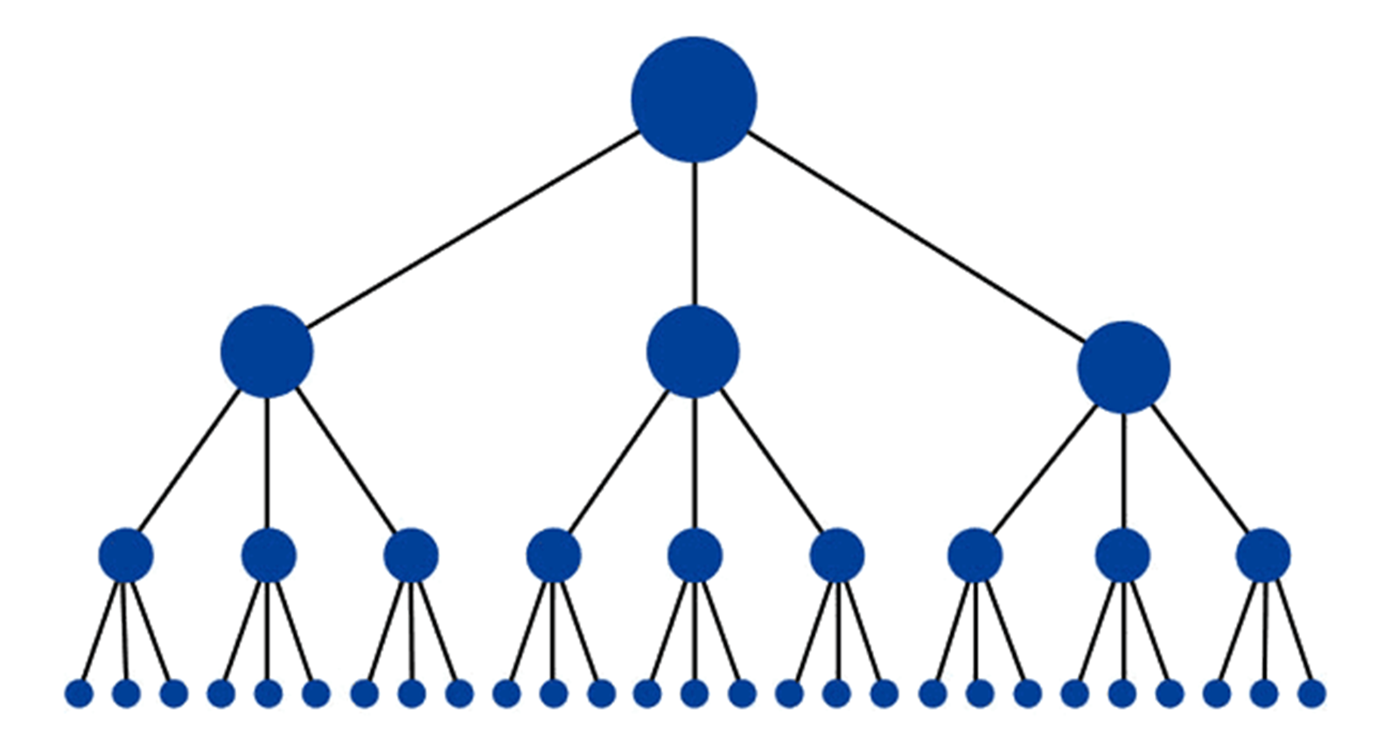

Slide 27



COGNITIVE DOMAIN
DIGITAL DOMAIN
PHYSICAL DOMAIN

Slide 28
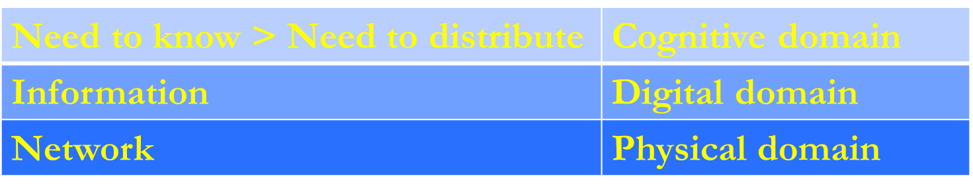

Slide 29
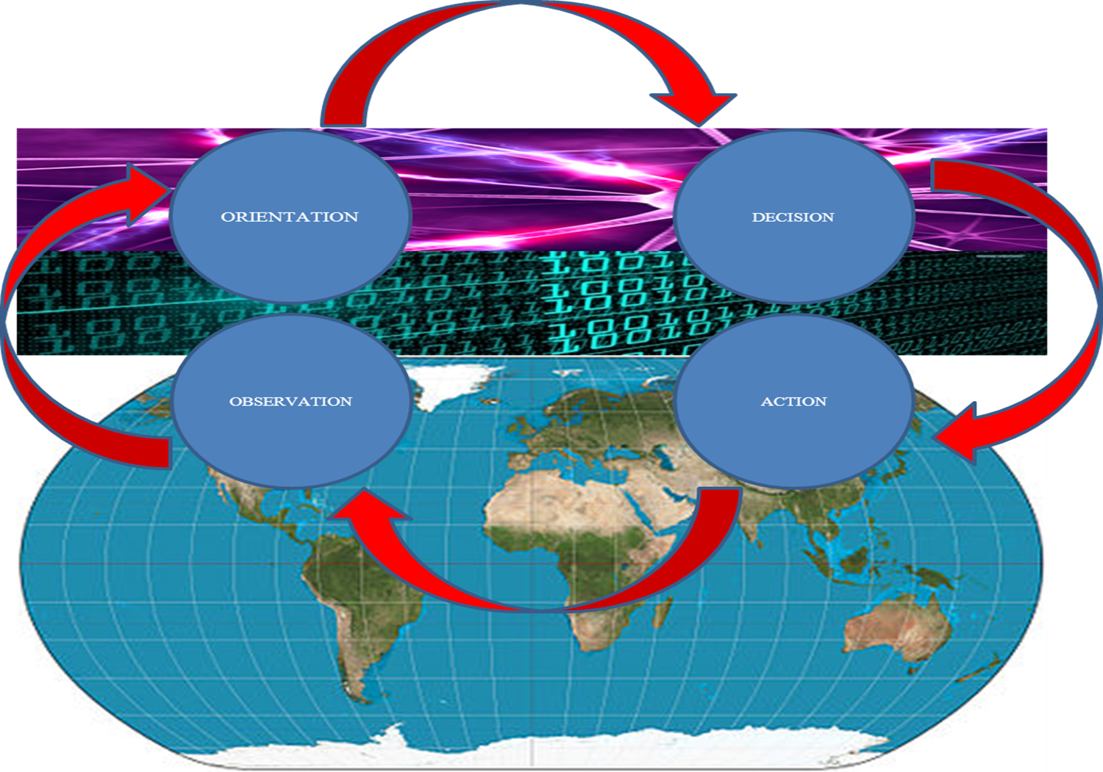

Slide 30
04. Network Centric Warfare

Slide 31


Slide 32
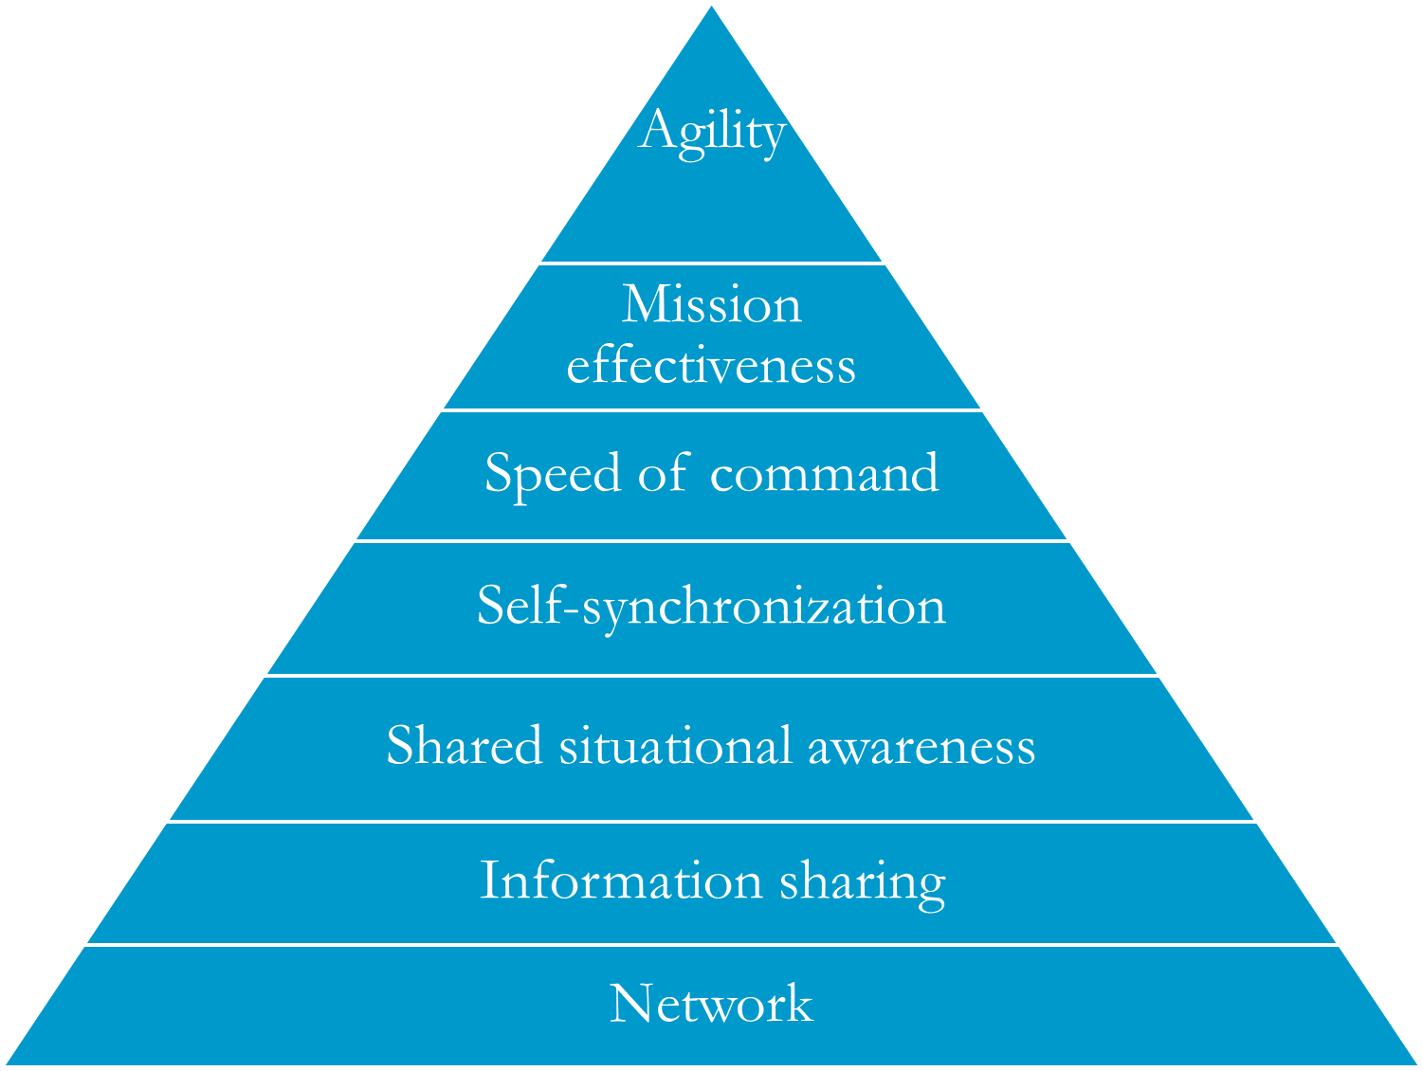

Slide 33
The network centric warfare allows for combat power to be generated by the network connections between sensors, command elements and shooting systems.
This network allows for a unitary image of the battlefield to be created and distributed to all the elements in the network, which ensures self-synchronization between the various geographically dispersed elements for the intentions of the command structure to be carried out.

Slide 34
Two key force capabilities needed
by Information Age militaries are
INTEROPERABILITY AND AGILITY.
Organizations that are products of Industrial Age thinking are not well suited for significant improvements in interoperability or agility.

Slide 35
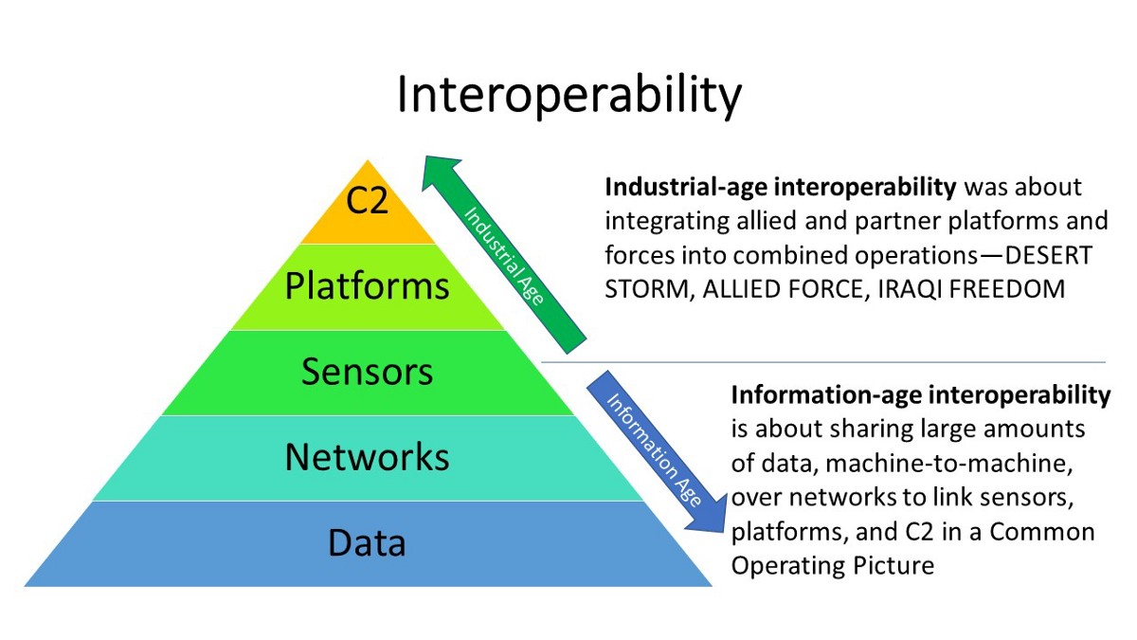

Slide 36
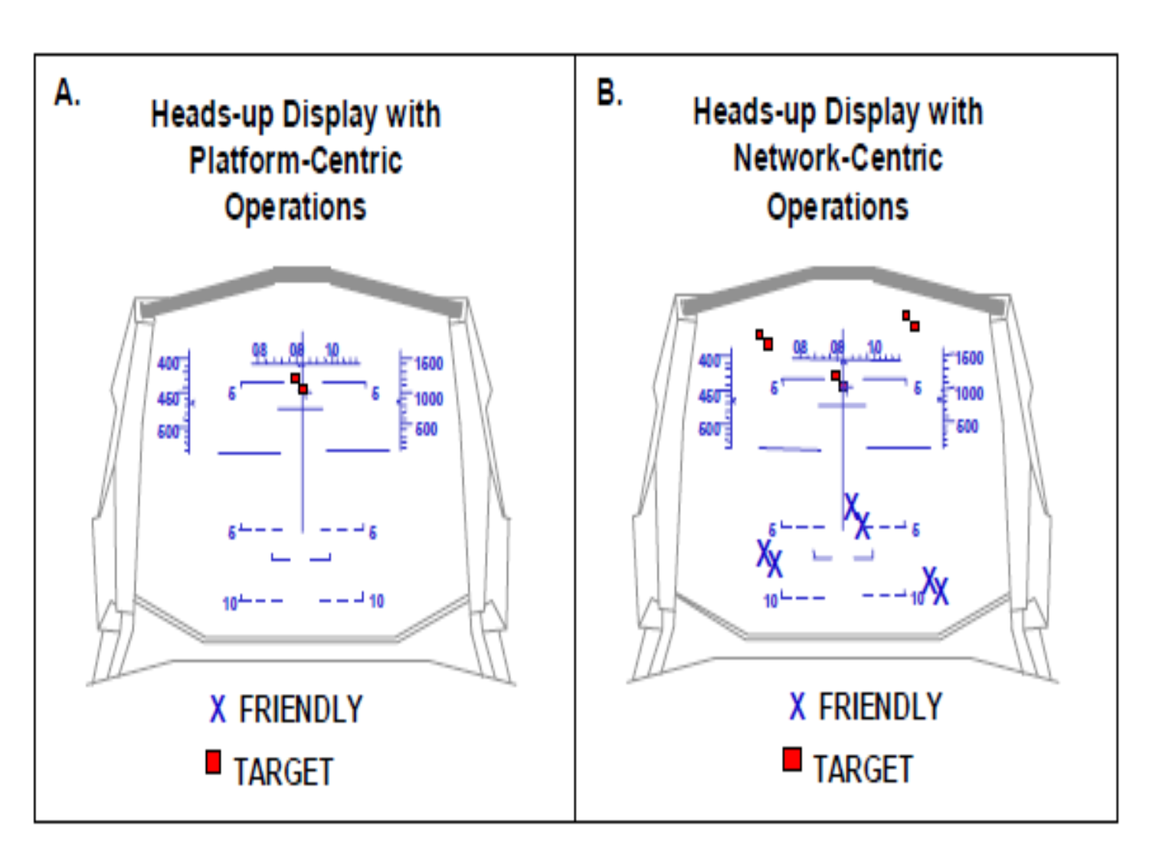

Slide 37
Thanks

